Slide 1
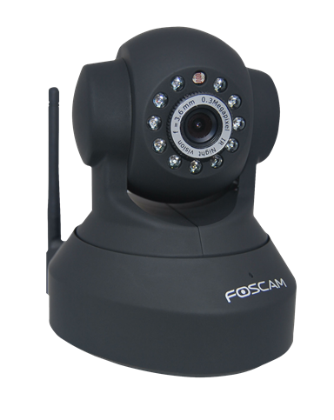
Degree Of Freedom And Rotacam (motion following camera)
Project based learning-1 (4th Sem)
Name: Ritvik Mahapatra
Reg. No.: 199403001

Slide 2
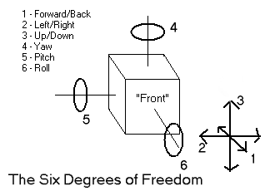
INTRODUCTION-The Problem, Need or Requirement.
In today’s world, mankind has various needs and requirements. These may range from one to other. But various needs in the domain of manufacturing or production are fulfilled by the implementations of machines and the knowledge in physics or mechanics, to a certain extent.
During production process which is automated we may need a certain machine element to move in certain direction or rotate about a particular axis. This is where concept of Degree Of Freedom comes.

Slide 3
Manufacturing is just an example, concept of DOF is applicable on most of the machines around us, may it be a fridge’s door, a table fan, AC’s which have controllable swing area {they may cool the area around by following you through a motion sensor and setting the swing of AC at that angle only} or a CCTV camera which can rotate itself at any angle by following the motion of an object or person.
We will here discuss a motion following camera which detects the motion from 4 ultra sonic sensors and the camera moves in the direction where the distance of the object is minimum from the sensors. Also, the camera input can be used to follow the object in place of ultrasonic sensors.

Slide 4
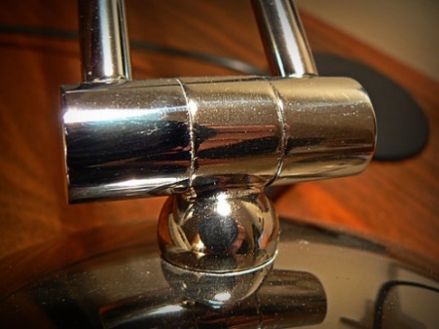
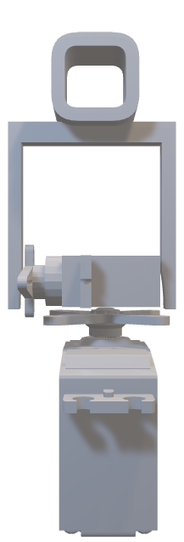
Degree Of Freedom
In physics, the degrees of freedom (DOF) of a mechanical system is the number of independent parameters that define its configuration or state. It is important in the analysis of systems of bodies in mechanical engineering, structural engineering, aerospace engineering, robotics, and other fields.
The formulae for DOF is given by 6(n-1)-5p1-4p2-3p3-2p4-p5
For our case we have 3 links (n=3)(2 servos and 1 camera link) and p1=2(pair of links whose DOF is 1(reduced by 5) i.e., about x and y axis), therefore our DOF comes out to be 12-2*5=12-10=2
3
2
1

Slide 5
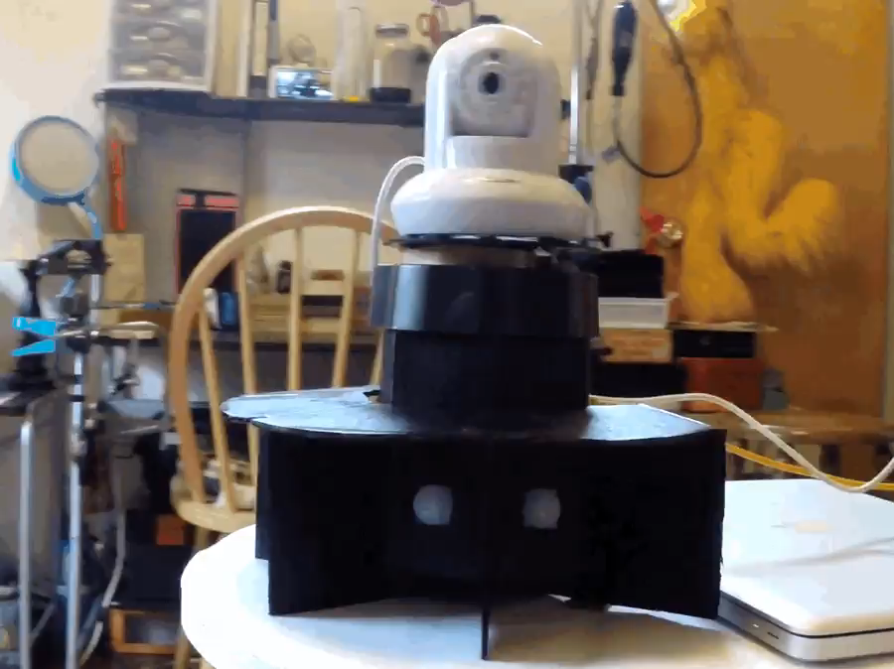
Using Arduino for implementation of 2 DOF motion following camera
Construction and 3-D model
Firstly, there are 4 Ultrasonic Sensors which determines the distance of the object from themselves so that we know in which direction the camera should rotate such that it follows the object (we consider the object to be in the front of our setup).
Then we have two servos, one is fixed with ground (giving 360 view about x axis, we will consider for 180 degree only). The other servo fixed on the rotator of 1st servo, such that their axis are perpendicular to each other (this can rotate about 270 degrees about y axis; however, we will limit it to 180 degree only).

Slide 6
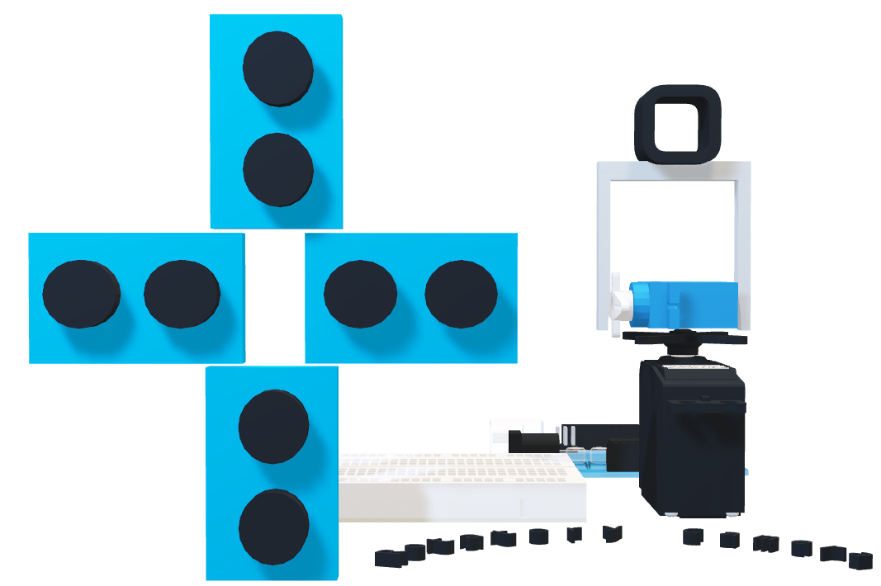
We have connected/fixed the camera with the help of connections as shown in the figure (initially, along the axis of the first servo). The camera faces the front direction. The DOF of the setup is 2 as it rotates about x-axis and y-axis.

Slide 7
Circuit
To implement a 2 DOF motion follower (about x and y-axis about 180 degrees) we have used four ultrasonic sensors (namely top, bottom, right and left) to detect the object and its distance from the sensors, so that the camera can rotate in the direction where the object is detectable or the nearest to the sensor. The Arduino is being used to detect the inputs; it also finds out the distance between the object and the sensor so that the camera can rotate in the direction of the object (that is, in the direction where distance in minimum or where the sensor detects the object). Two of the servos are connected to the Arduino to control the angle of rotation of the camera, respectively.

Slide 8
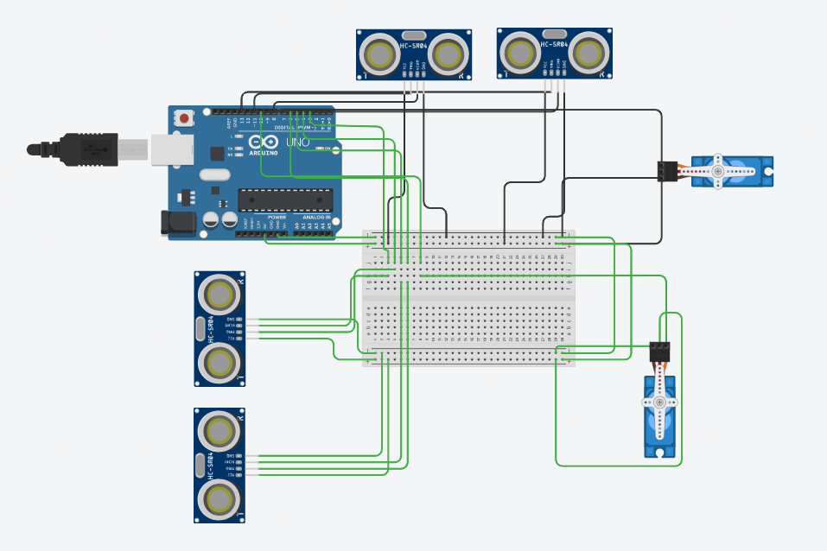
The ground and the power of all the elements are connected with the Arduino’s gnd and 5v terminal, respectively. The servos signals are received from the pin 9 and 10 of the Arduino.

Slide 9
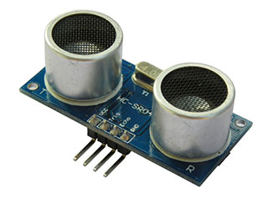
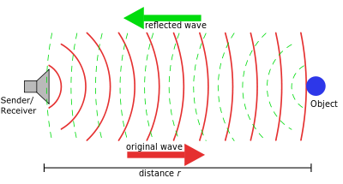
Ultrasonic sensor
The ultrasonic sensors used here have the echo and trigger terminal. The trigger pin is in input pin for the ultrasonic sensor. The trigger takes the input from the Arduino and If it’s high the transmitter of the sensor emits the ultrasonic wave, if the object is encountered, then the waves are reflected to the sensor and the receiver part of the sensor detects the reflected U.S. wave. This enables the echo(output pin of the sensor) to go high, which can be used to determine the time after the sensor receives the signal, i.e., the time difference between the trigger pin going high and echo going high (receiving the signal). From the time we can find the distance of the object with the help of some relations.

Slide 10
Code Explanation
Firstly, we have included the servo library for controlling the angle of rotation and declared to two servo’s object (horizontal and vertical).
Declaring all the input/output pins and variables. Taking the initial threshold (distance from the sensor as ten inches and initial angle for both the servos as 90 degrees.
Void setup() – here we setup the servo signal pins.
Void loop() –
setup the trigger input for every sensors and set the trigger as high then low for certain time so that the signals are sent.
Then we determine the time after which the output of ultrasonic sensor (echo) goes high for each sensor (using pulse In function).
Then we find out the distance of the object from each sensor by using relation distance(in) = time difference(mS)/148 (v=0.00675 inches/mS or 6750 inches/sec, 170 m/sec)
Then we call the follow function for each of the servo.

Slide 11

Void follow() (for horizontal servo-right and left ultrasonic sensor):
First, we check whether the distances are greater than the threshold(distance or range limit) or not.
If any one of the distances is more than the threshold distances, then we compare the distances of both the ultrasonic sensors (right and left).
For e.g., if the right sensor’s distance is less than the left sensors distance by a minimum difference of 2 inches then the servo should rotate in the right direction, i.e., in the right direction as the object is closer to right sensor.
Similarly, if left sensors distance is less the servo rotates in left direction.
The minimum and maximum limits are 0 and 180 degree (no rotations beyond these limits).
Similar process repeats for the vertical servo: - up and down U.S. sensor.
These processes under void loop() repeats continuously.

Slide 12
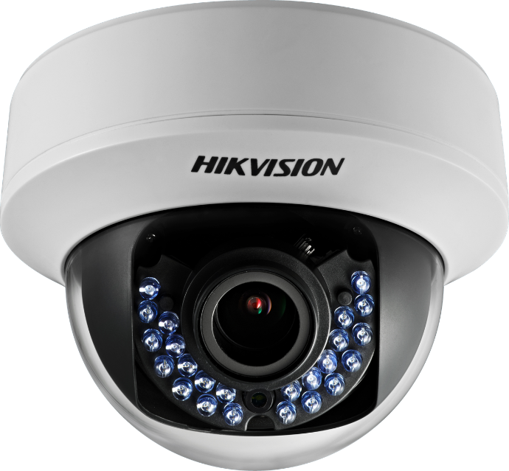

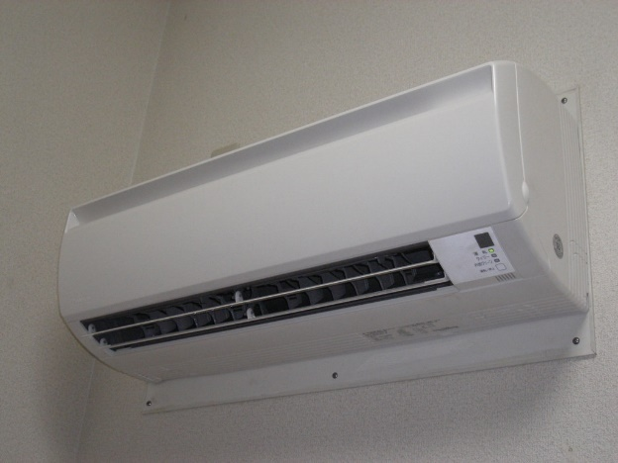
Applications Of The Motion Follower System
Security / CCTV cameras and system.
Smart lighting system- lights following the person.
AC swing control- supplying the cool air where more people are there.
Environmental sensing.
Automation of manufacturing and production processes.

Slide 13
Links and Bibliograph
Link for 3D model- https://www.tinkercad.com/things/8CCBkukoogv-rotacam-motion-follower-model
Link for Circuit- https://www.tinkercad.com/things/7eray7TTn8B-rotacam-motion-follower-circuit
Bibliograph-
Instructables. (2018, August 18). Motion Following Robot. https://www.instructables.com/Motion-Following-Robot/
Motion Following Motorized Camera Base. (n.d.). Arduino Project Hub. Retrieved May 26, 2021, from https://create.arduino.cc/projecthub/lindsi8784/motion-following-motorized-camera-base-61afeb
Santos, R. (2019, April 2). Complete Guide for Ultrasonic Sensor HC-SR04 with Arduino. Random Nerd Tutorials. https://randomnerdtutorials.com/complete-guide-for-ultrasonic-sensor-hc-sr04/
Tinkercad | From mind to design in minutes. (n.d.). Tinkercad. Retrieved May 26, 2021, from https://www.tinkercad.com
Wikipedia contributors. (2021, March 25). Degrees of freedom (mechanics). Wikipedia. https://en.wikipedia.org/wiki/Degrees_of_freedom_(mechanics)#:%7E:text=In%20physics%2C%20the%20degrees%20of,define%20its%20configuration%20or%20state.&text=The%20position%20of%20a%20single,the%20distance%20along%20the%20track.

